Slide 1
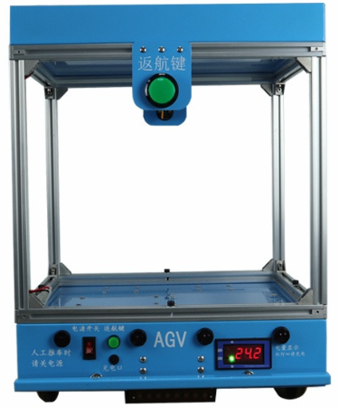
Wave soldering pallet return system
Description
This unit is used to return wave soldering pallet in Automatic
Features
Automatic transportation between A and B with linear reciprocating (single direction and multi stop stations)
Max Load: 30KG
Max speed: 400mm/s
No load battery Life: 50 Hours
Average charging time: 6Hours
Charging Voltage: AC220V--CD25.2V5A
Dua security protection
8 infrared sensor
Anti collision switch strip
Heighten aluminum frame
Voltage less than 19.2V, voltmeter will atuomatically alarm with red light on.
20 meters navigation bar
2 stop lines
2 midway station stop lines
Specifications
Model | Dimension (L*W*H.MM) | Pallet size(MM) | Weight | Battery Capacity
SAGV30C | 430*370*500 | 430*370*50 | 16KG | 30HA
Adviced Option
Spare Batteries

Slide 2
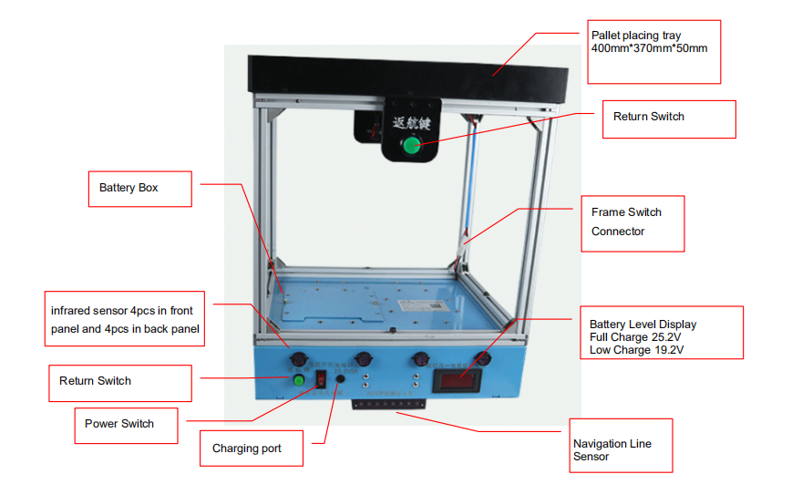
Wave soldering pallet return system

Slide 3
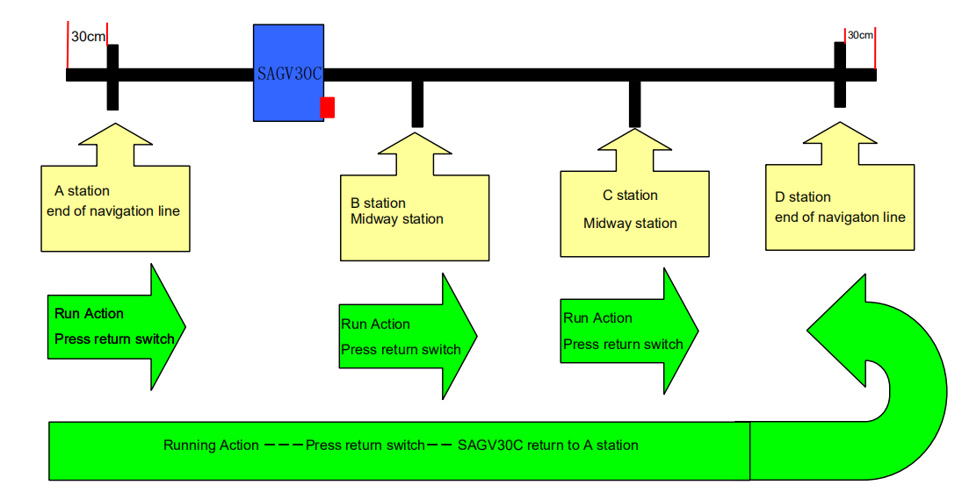
Wave soldering pallet return system

Slide 4
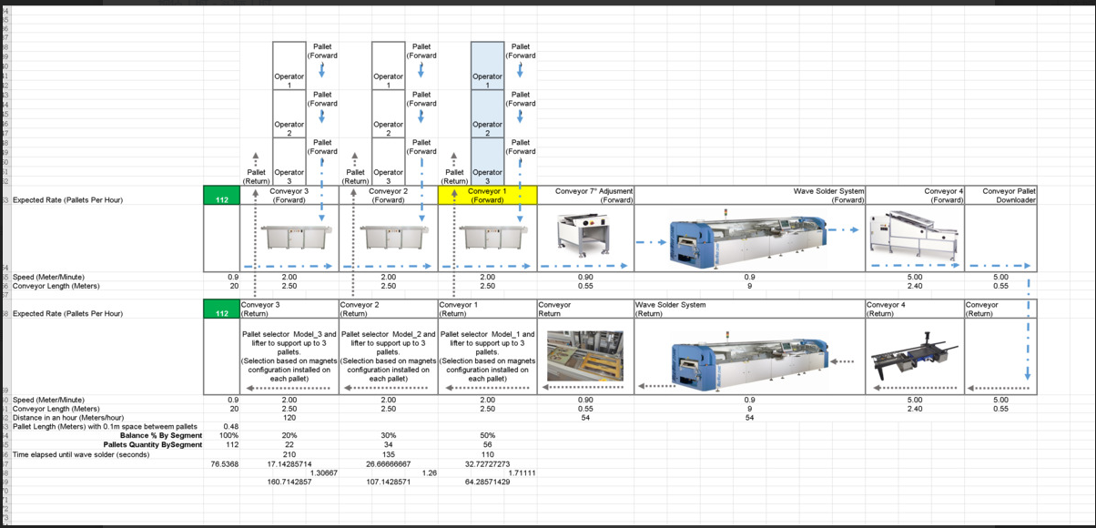
Wave soldering pallet return system

Slide 5
WELCOME INQUIRY
Please visit
www.smthelp.com
Find us more
https://www.facebook.com/autoinsertion
Know more our team
https://cn.linkedin.com/in/smtsupplier
Welcome to our factory in Shenzhen China
See more machine working video, please Youtube
Auto Insertion
Google
Auto+insertion, to get more informations
Looking forward to your email
info@smthelp.com

